Slide 1
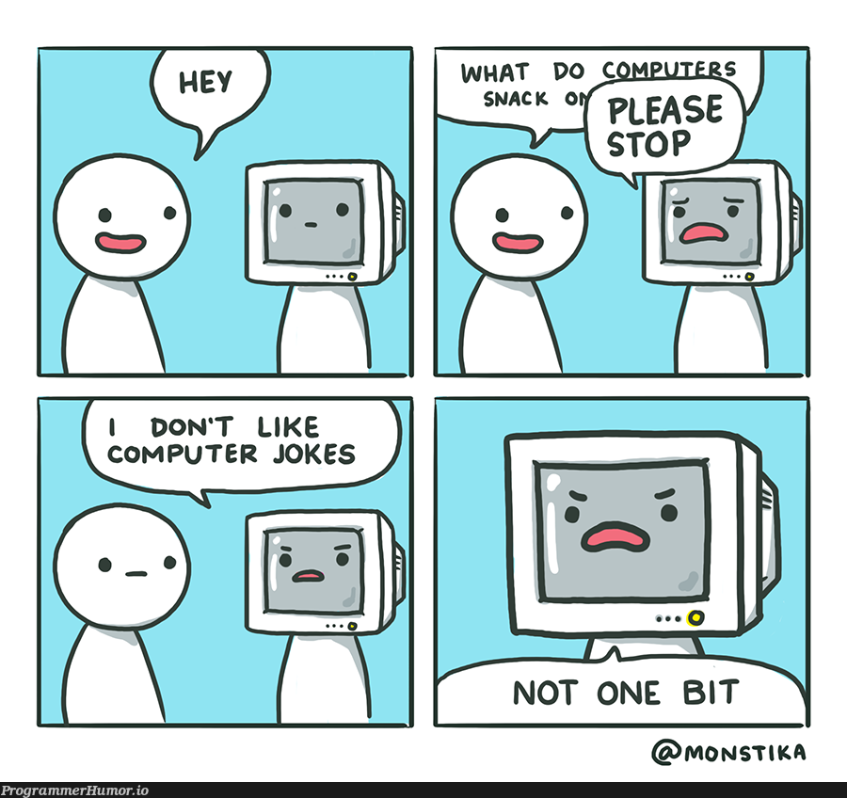
Introduction to the role of computer in the humanities
Shanmugapriya T

Slide 2
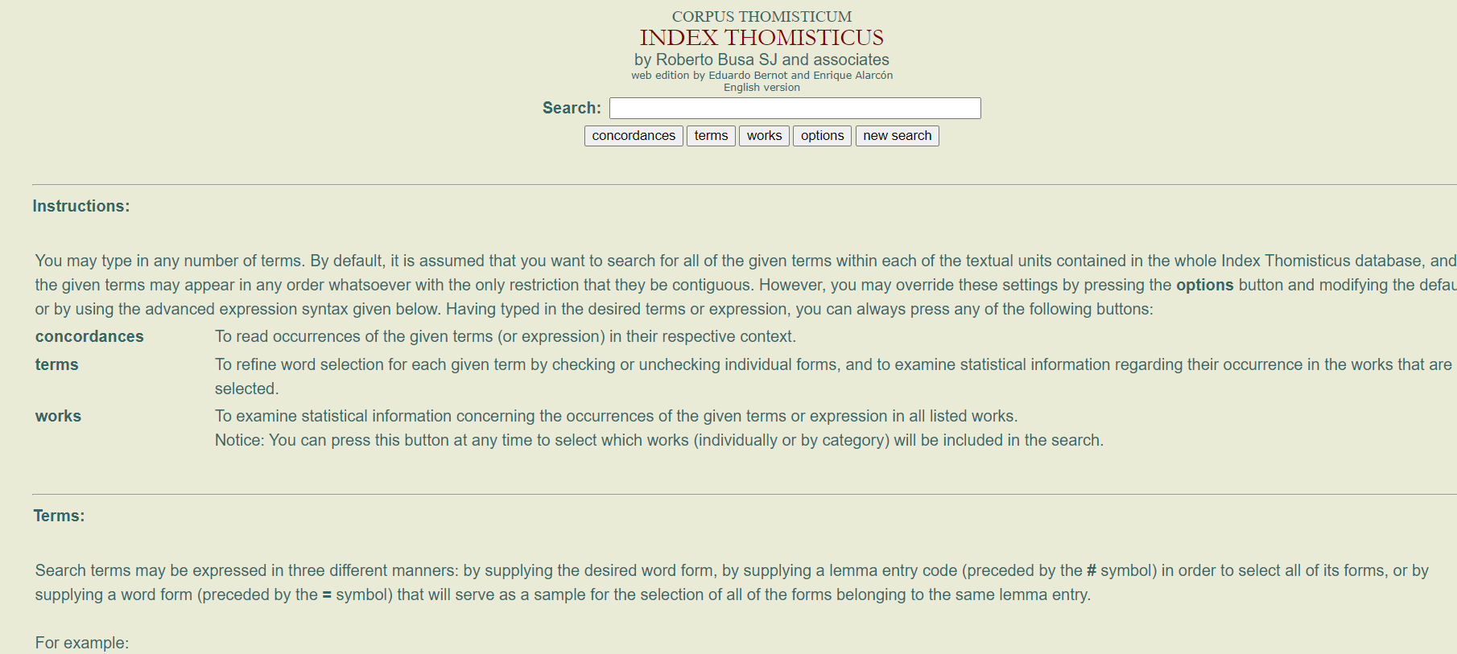
IBM

Slide 3
Computer and Humanities Scholarship
Industrial Revolution (what is it first? ) (remember Renaissance from our last class)
Computer Revolution
Isaac L. Auerbach :
“the computer and its application to information processing "will have a far greater constructive impact on mankind during the remainder of the 20th Century than any other technological development of the past two decades.“ “ (Bowles 269)
Knowledge production and various ontological structures

Slide 4
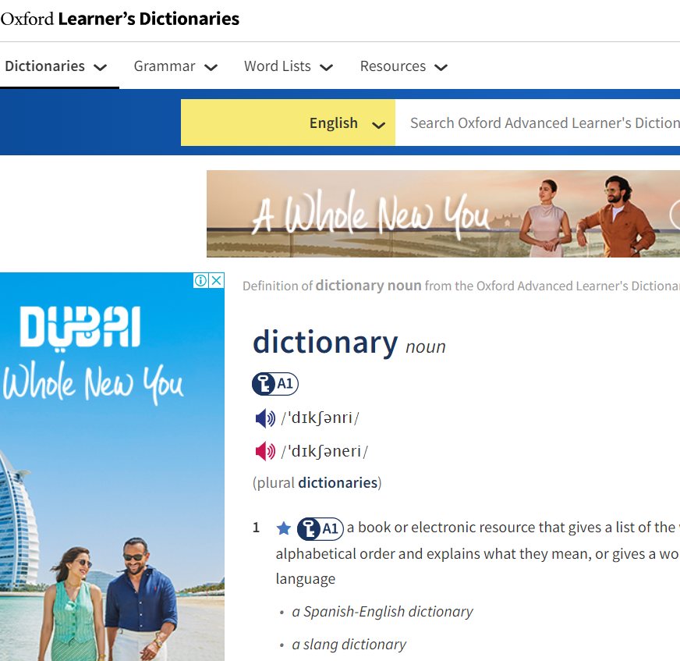
A few comparisons
Oxford English Dictionary took some 80 years to complete with several generations of editors
Thomas Aquinas (approximately 13 million words) would take 50 scholars 40 years to accomplish the task of indexing the words (a few scholars and less than a year)

Slide 5
Suspicious!
A Scottish minister and mathematician sent an article on the use of the computer in biblical scholarship to a publisher. It was returned promptly with a notation, "I do not understand this, but I am quite sure that if I did understand it it would be of no value." One scholar said a few years ago that, "If you have to use a computer to answer a question, it is not a question which I would care to put." (Bowles 270)

Slide 6
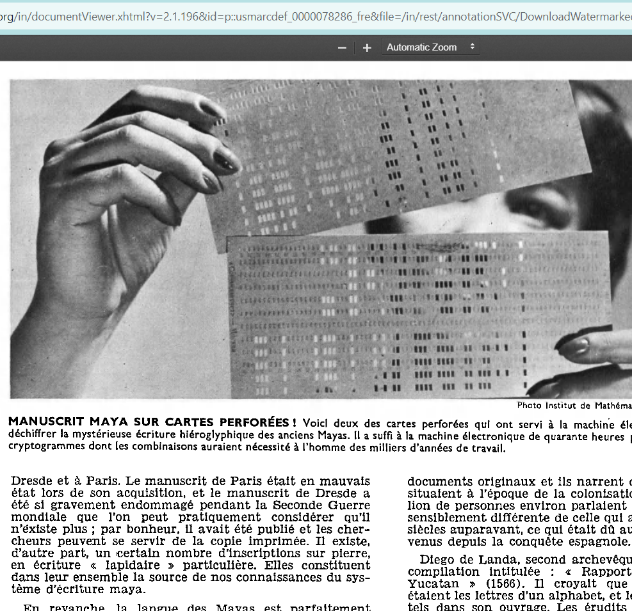
A few earlier examples (Bowles)
The deciphering of the Mayan hieroglyphic script by Russian mathematicians took only 40 hours of computer time for which a human being would have needed thousands of years to accomplish (Bowles 270)

Slide 7
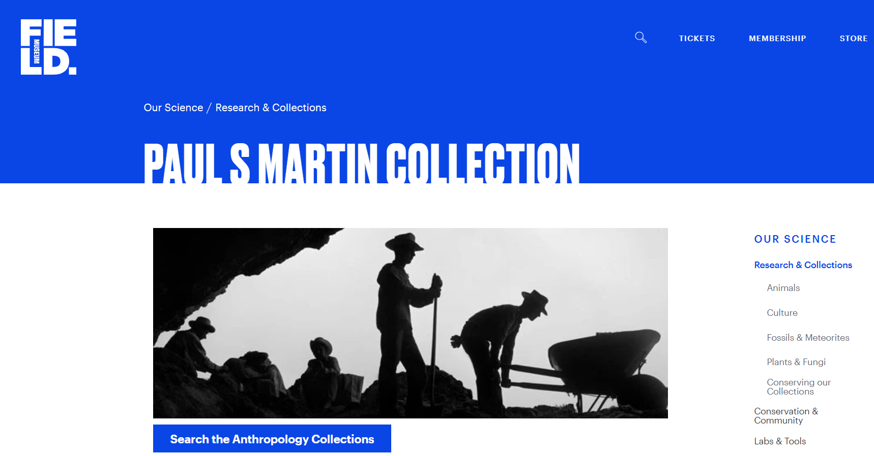
Archeology (1960s)
The computer is used to study shards or fragments of artifacts found in the diggings of ruins
Ex. Dr. Paul S. Martin and his associates at the Chicago Natural History Museum have been using the IBM 7094 computer at the University of Chicago to process archeological data from the southwestern United States

Slide 8
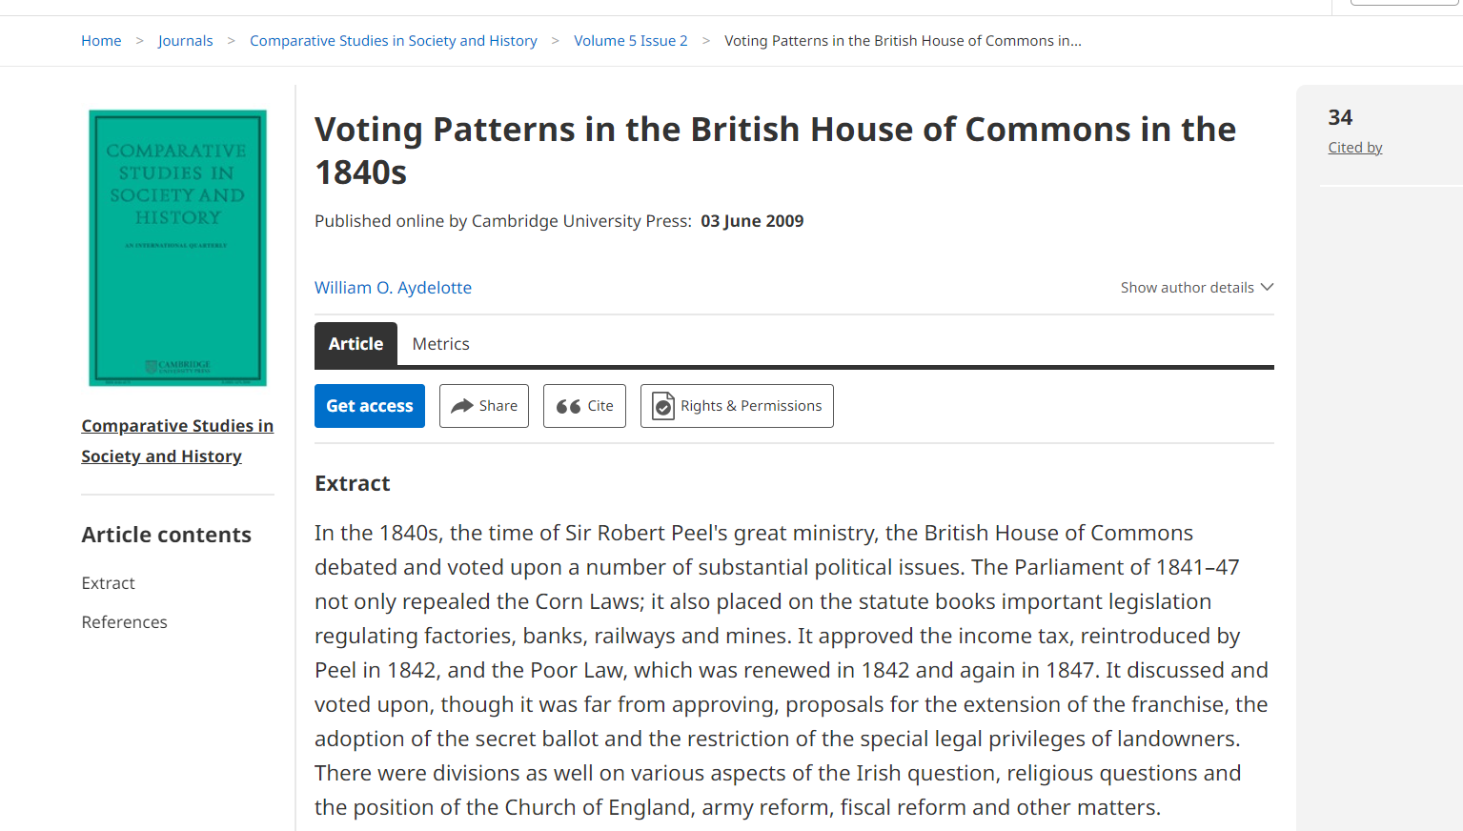
History, English and Music etc. (1960s)
Automatic extraction of information from the historical documents
Literary styles
Author attribution
Pattern attribution

Slide 9
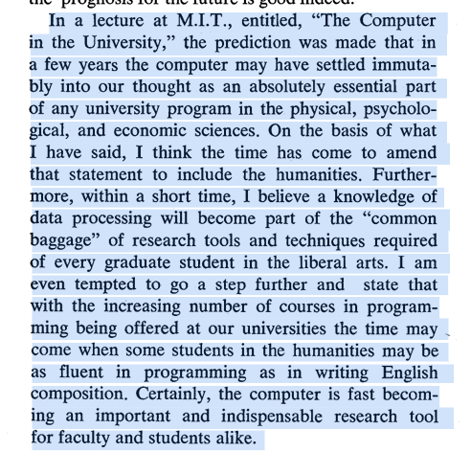

Slide 10
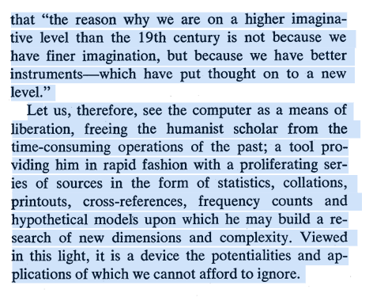
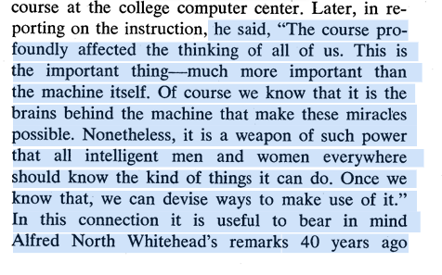

Slide 11
What is humanities computing ?
Why is it changed from humanities computing to digital humanities?
What is digital humanities exactly then ?

